Slide 1

Credit One
Data Science Process Report
Predicting the probability of default
Presented by Magdalena Kobusinska

Slide 2

Data Science Process
The put forth data science process – BADIR - is focused on understanding the business, needs and objectives, as well as defining the milestones and needed analysis.
Business questions
Analysis Plan
Data Collection
Insights
Recommendations

Slide 3
Business Questions
What are the key factors to decide one’s probability of default?
What is the best way to decide how much credit allow the customers to get?
What are the odds and what can be done to avert Credit One collapse because of increasing number of people who defaulted on loans?

Slide 4
Analysis Plan
Access the data
Extract and sava data into Python dataframe
Examine data (data type & columns use)
Clean the data up
Explore the data (EDA)
Perform in-depth analysis (create and evaluate predictive models)
Answer the business questions
Picture the results and conclusions

Slide 5
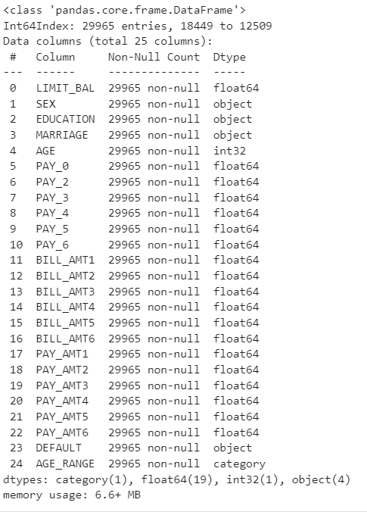
Data Collection
Data source: MySQL database,
Credit One company
Data saved locally as CVS file
Data specification:
25 columns
29965 entries
Data analysis:
Jupyter notebook with python
(matplotlib, numpy, pandas, seaborn libraries used)

Slide 6
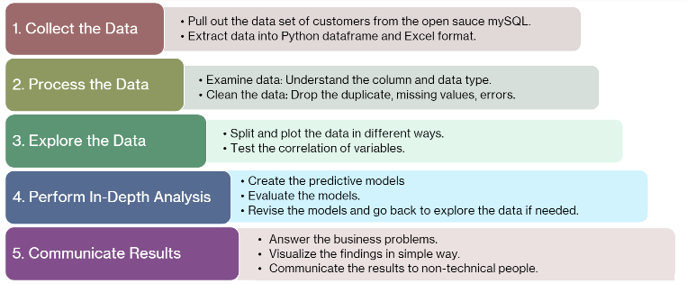
Detailed process

